Slide 1
NAT
Network Address Translation

Slide 2
Network Address Translation

Slide 3
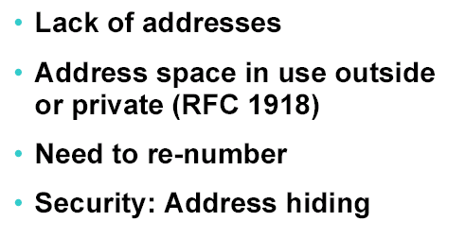
Why NAT

Slide 4
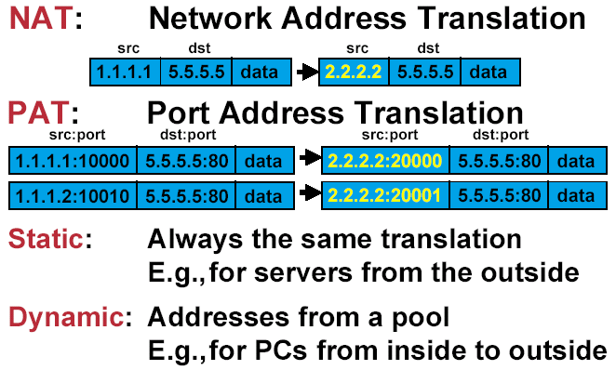
NAT Terminology

Slide 5
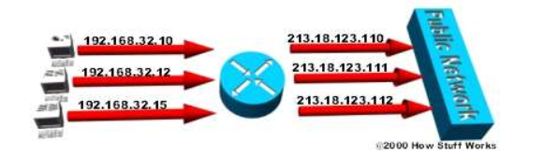
NAT : Network Address translation
One-on-One relationship
    internal (local) → external (global)
Only on Layer 3 – IP addresses
Static vs Dynamic

Slide 6
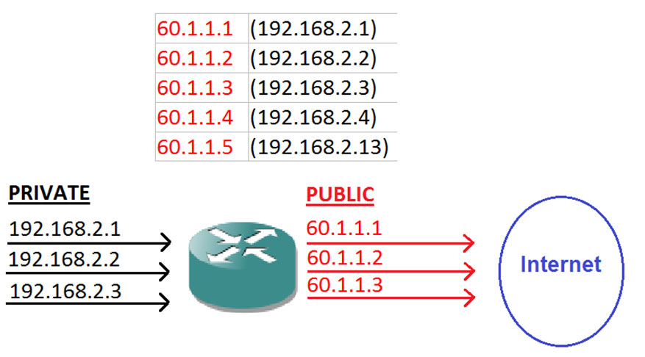

Slide 7
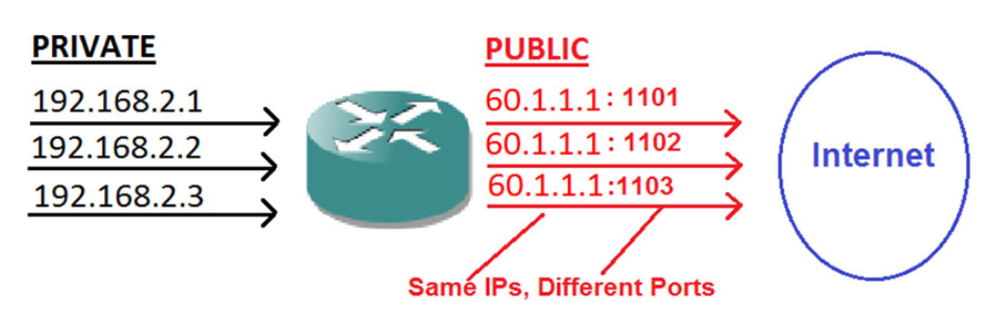

Slide 9
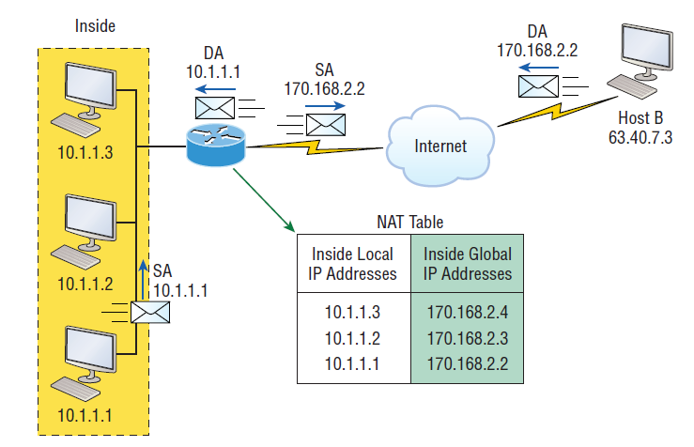


Slide 10
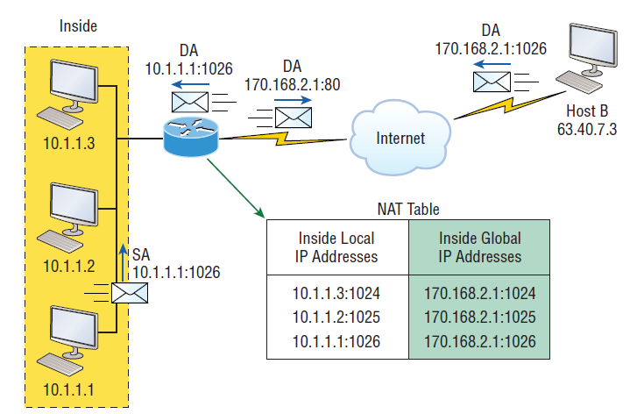

Slide 11
NAT Terms
Inside Local Addresses – An IP address assigned to a host inside a network.
Inside Global Address – An IP address assigned by the NIC or service provider that represents one or more inside local IP address to the outside world.
Outside Local Address - The IP address of an outside host as it is known to the hosts in the inside network.
Outside Global Address - The IP address assigned to a host on the outside network. The owner of the host assigns this address.

Slide 12
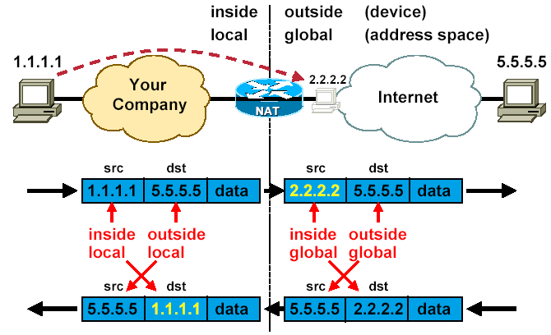
The inside – outside – local – global

Slide 13
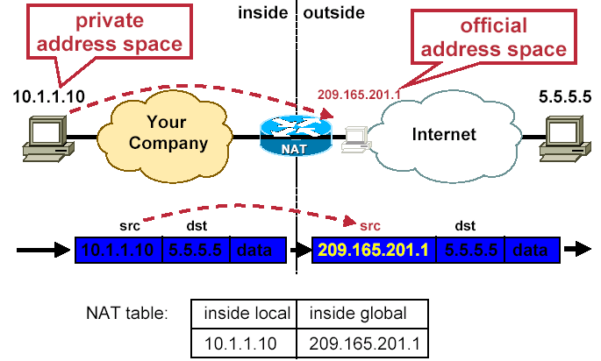
Source NAT : Overview

Slide 14
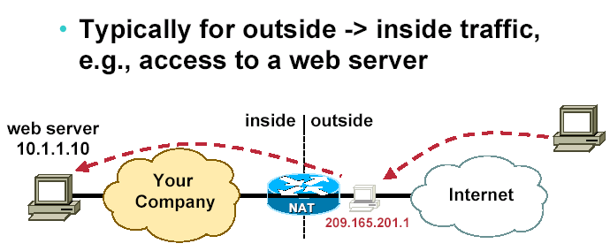
Static source NAT

Slide 15
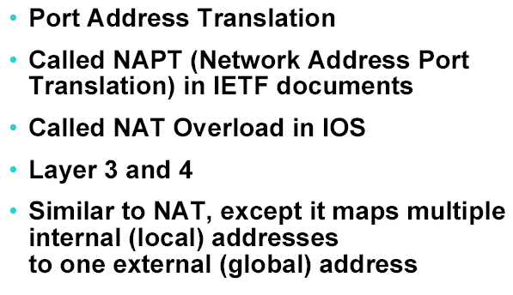
PAT Terminology

Slide 16
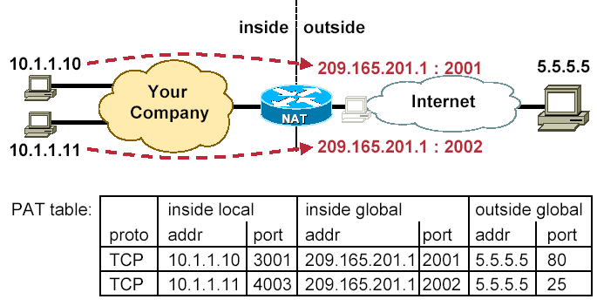
PAT or “NAT overloading” - Overview
Only outbound ! Unless static PAT

Slide 17
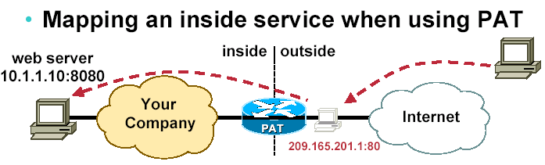
Static PAT

Slide 18
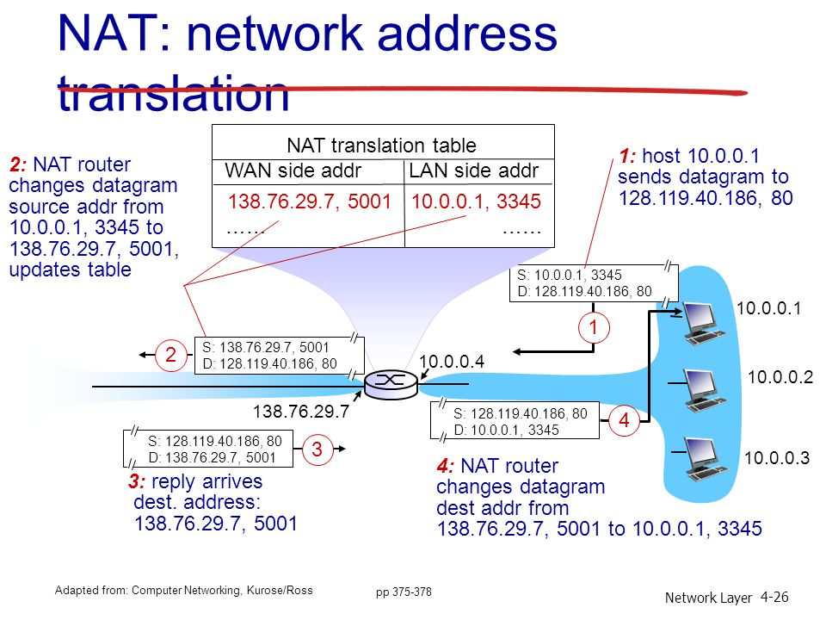

Slide 19
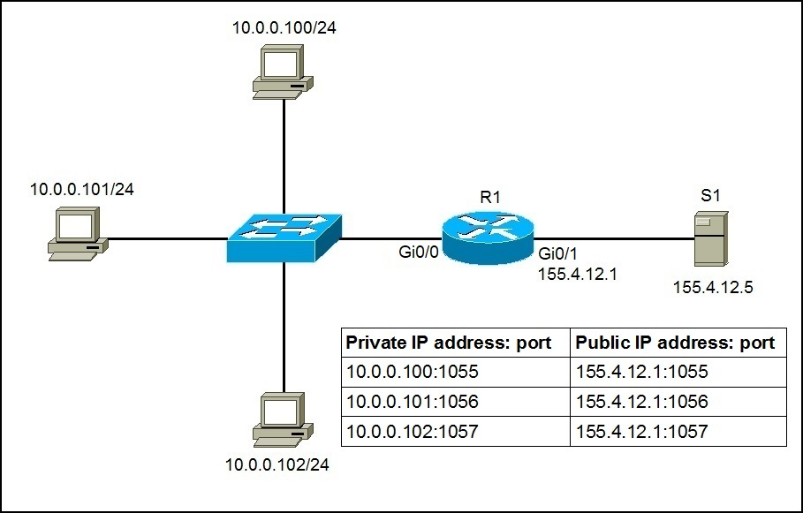

Slide 20
https://forms.gle/U7i7um96fxphTZ8h6

Slide 21
Access Control List
An access control list (ACL) is a table that tells a computer operating system which access rights each user has to a particular system object
Access Control Lists “ACLs” are network traffic filters that can control incoming or outgoing traffic.
ACLs work on a set of rules that define how to forward or block a packet at the router’s interface.

Slide 22
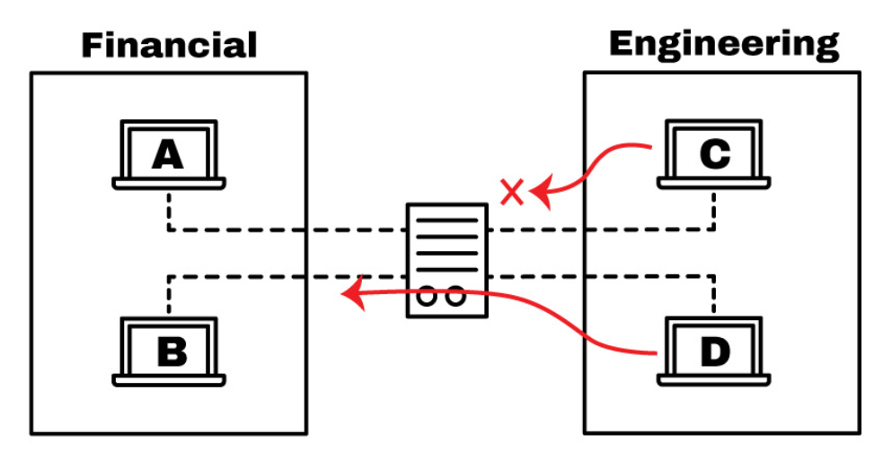

Slide 23
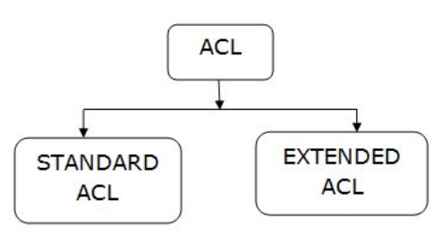

Slide 24
Standard ACl Vs Extended ACL
Standard access lists
These ACLs use only the source IP address in an IP packet as the
condition test. All decisions are made based on the source IP address. Extended access lists
Extended access lists can evaluate many of the other fields in the layer 3
and layer 4 headers of an IP packet.
They can evaluate source and destination IP addresses, the
Protocol field in the Network layer header, and the port number at the Transport layer header.

Slide 25
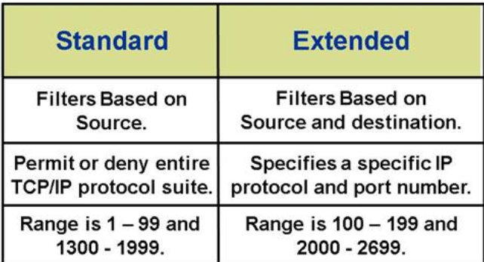

Slide 26
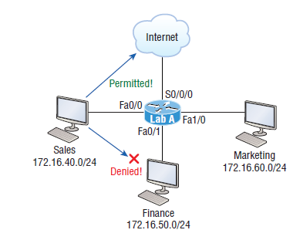
Lab_A(config)#access-list 10 deny
172.16.40.0 0.0.0.255
Lab_A(config)#access-list 10
permit any

Slide 27
Thank you

